Slide 1
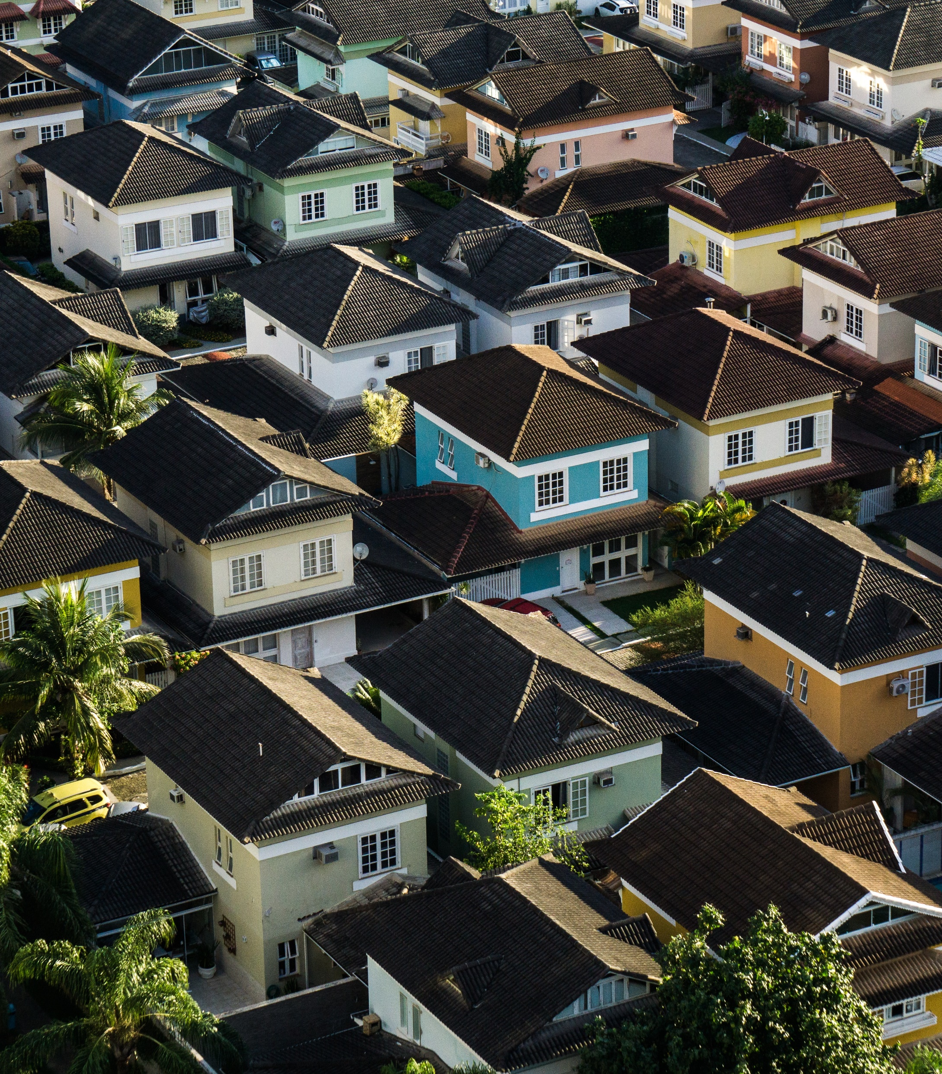
U.S. Real Estate Investment Opportunities
ZED² Solutions
Spring 2018

Slide 2

Agenda
Headlines / Assumptions
Methods
Findings
Recommendations / Future Work

Slide 3
Headlines
Research provided information on US cities with upward trending population growth
City | Pop. Growth 2017 → 2018
Provo-Orem, UT | 2.6%
Bend-Redmond, OR | 2.8%
Boise City, Idaho | 2.9%
Greeley, CO | 3.0%
The Villages, FL | 3.1%
Odessa, TX | 3.2%
Midland, TX | 4.3%
38
Unique Zip Codes
Notes:
Started with 14,723 zip codes across the US, starting as early as April 1996, up through April 2018. Trimmed the data down to begin at January 2010, avoiding the noise in market trends caused by the 2008-9 market crash

Slide 4
Assumptions
ROI is calculated assuming the property is purchased outright with no financing
Rent is set at 1% of the property value, assessed and raised annually
Maintenance averages 1% of the annual property assessment
Insurance and property taxes cost an additional 1% per year, bringing the assumed annual return to 10% of property value
Properties will be rented without interruption for a period of 5 years and then sold at the projected average home price of the given zip code

Slide 5
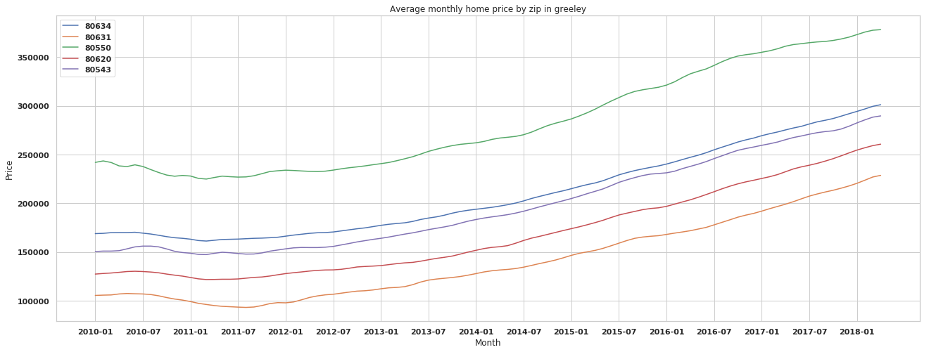
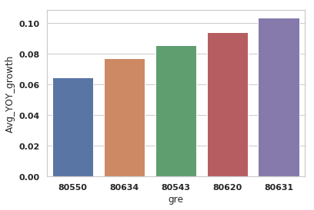
Methods
Began by inspecting the general shape of the data
Calculated the average YOY growth by zip code
Notes:
Began to understand how cities might look slightly different with a general trend of consistent growth. Some were more sluggish to trend upwards out of the market downturn, sagging into 2010-11.
Then calculated which zip codes across the 38 had the highest annual increase in property value averaged across 2010-2018. This was the approach to ensure consistency in performance and remove bias of just the most recent few years.

Slide 6
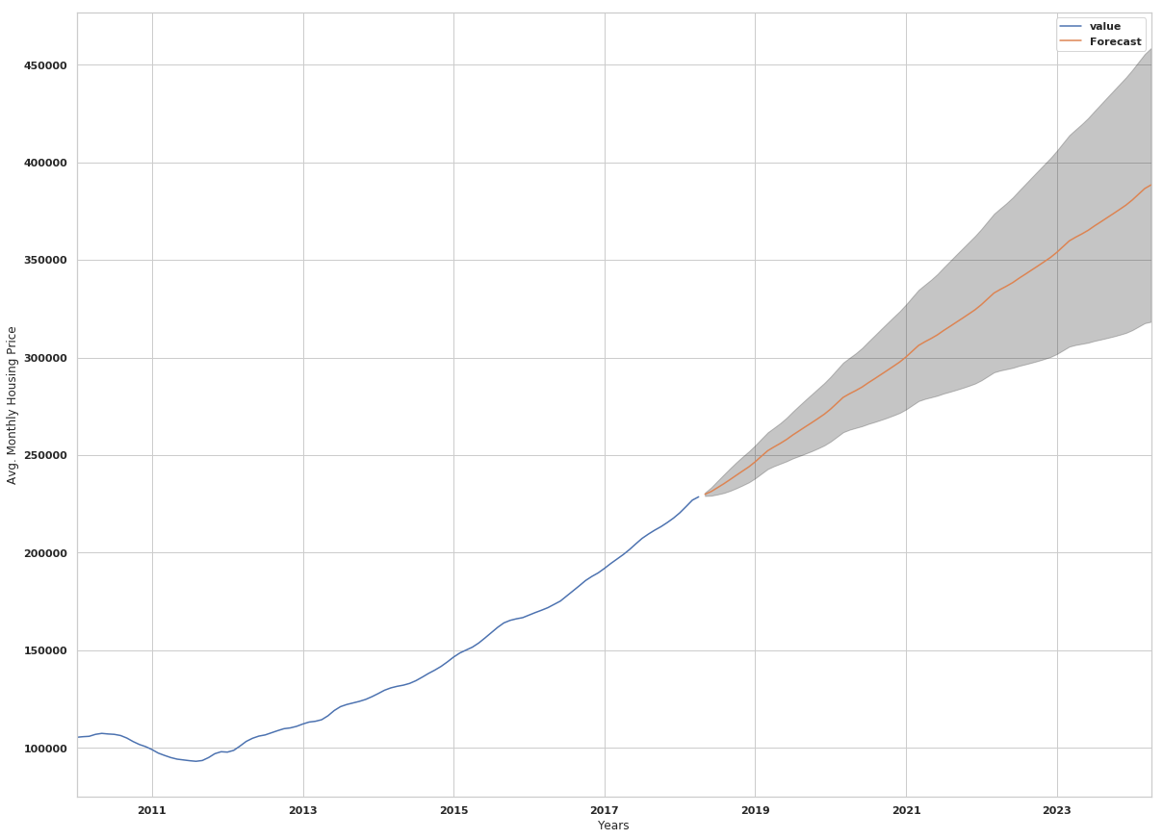
Methods
Use Auto Regressive Integrated Moving Average models to predict growth over the next 5 years with confidence intervals
Notes:
I leveraged the capabilities of Python’s statsmodel package to construct SARIMA models for the 10 zip codes that showed the highest average annual increase in average property value over the examined time period. Modeling involved generating stationary data, examining ACF (autocorrelation function) and PACF (partial autocorrelation function) plots to determine seasonal trends and the number of significant lag periods. Multiple parameters were iterated and final parameters were selected based off a balance of minimizing the AIC score of the model and selecting a model with the simplest solution (parsimony principal).
P-values were examined to determine the significance of the feature coefficients. Diagnostics were run to ensure normality of model residuals along a linear trend, the absence of seasonality, and low residual correlation with lagged versions of themselves.
Again, the power of statsmodels was leveraged to forecast future average property values for 72 periods (months) or 5 years.

Slide 7
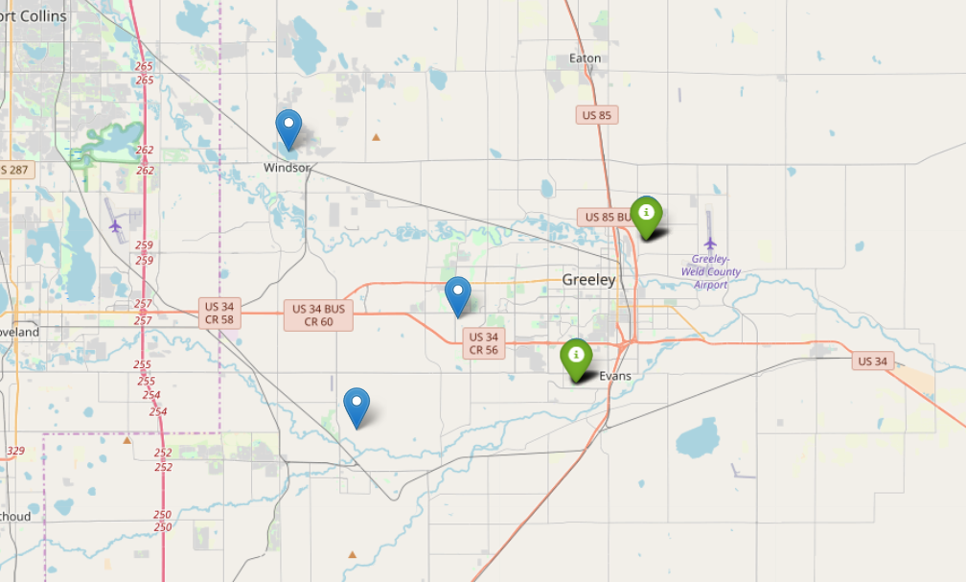
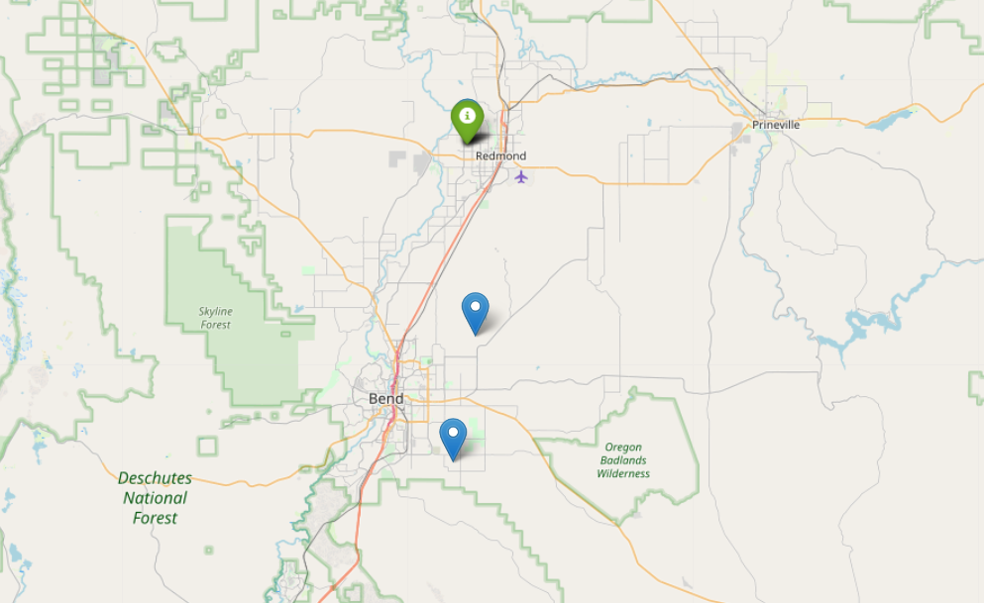
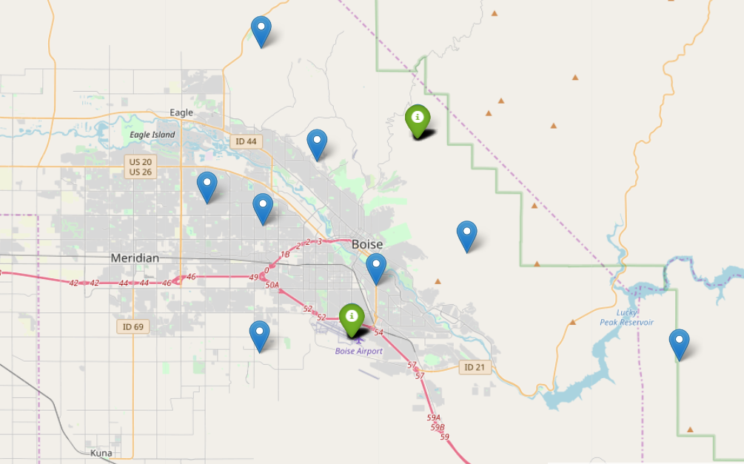
Findings
Of the 10 zips chosen to model, 5 were final selections
Proj. Avg. Annual ROI
12.4-13.1%
Notes:
Projected Annual ROI is the 5-year average annual return on the cash investment of the property, assuming rent revenue is 1% of the home value per month, adjusted for an annual property value increase matching the projected rate of growth predicted by the models, with total cost of the property totaling 2% of the property value annually. As the home value increases, costs are also increasing due to aging assets/more home maintenance.
The top 5 models predict earnings between 12.4 and 13.1%, which outperforms the industry benchmark of 6-12%

Slide 8
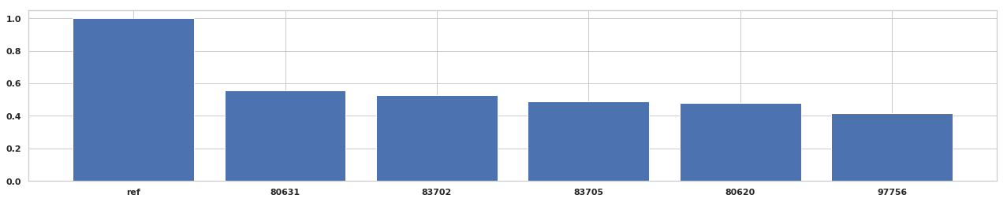
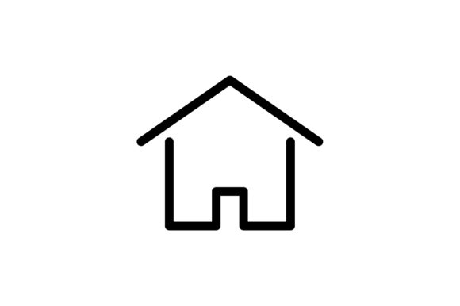
Findings
Zip | City | Projected Property Value Growth (%)
80631 | Greeley | 55.6
83702 | Boise City | 52.7
83705 | Boise City | 49.1
80620 | Greeley | 48.0
97756 | Bend-Redmond | 41.5
Notes:
5 years following the acquisition of the properties there might be interest in selling the properties to invest the capital elsewhere.
The models project the listed return on the sale of a property purchased at the current (April 2018) average property value and sold in April 2023. This does not factor in any costs that would be involved in major home repairs following rental tenants or general wear and tear on a property (new roof, repaved driveway, re-landscaping, etc.)

Slide 9



Recommendations
Purchase properties in Greeley, Boise City, and Bend-Redmond in the areas of town specified
Hold the properties for a minimum of 5 years to maximize ROI
Increase rent annually to match the market
Notes:
Again, modeling and recommendations are being made assuming properties are purchased in cash with no financing.
Increase rent annually to match the market – this could lead to renter turnover, so additional/continued analysis might be necessary to determine market climate

Slide 10
Future work
Additional research on other factors that might impact growth of property values
Expand the search to other growing areas, specifically to include some higher property value areas
Exploring the viability of actualizing the projected rates. Additional research on other costs of renting in these or other areas (taxes, property management, insurance, etc.) could produce stronger models
Notes:
While compiling the visualizations, it appeared areas near airports had higher projected future growth. Is that real or just coincidence?

Slide 11
Thank you!

